Slide 1



PRINTER MANAGEMENT SYSTEM
REVIEW 1
CREATED BY
SIDDHARTH.K
JEEVA.P
MEERA KRISHNAN.JM
ASHWIN.K
NAVVENDIRAN.M
1

Slide 2

INTRODUCTION
  In distributed computing environments such as enterprise networks, educational institutions, and shared office infrastructures, printers function as shared peripheral devices accessed by multiple client systems.
  However, the absence of centralized monitoring mechanisms often results in inefficient resource utilization, uncontrolled print job execution, increased operational expenditure, and delayed fault detection.
2

Slide 3
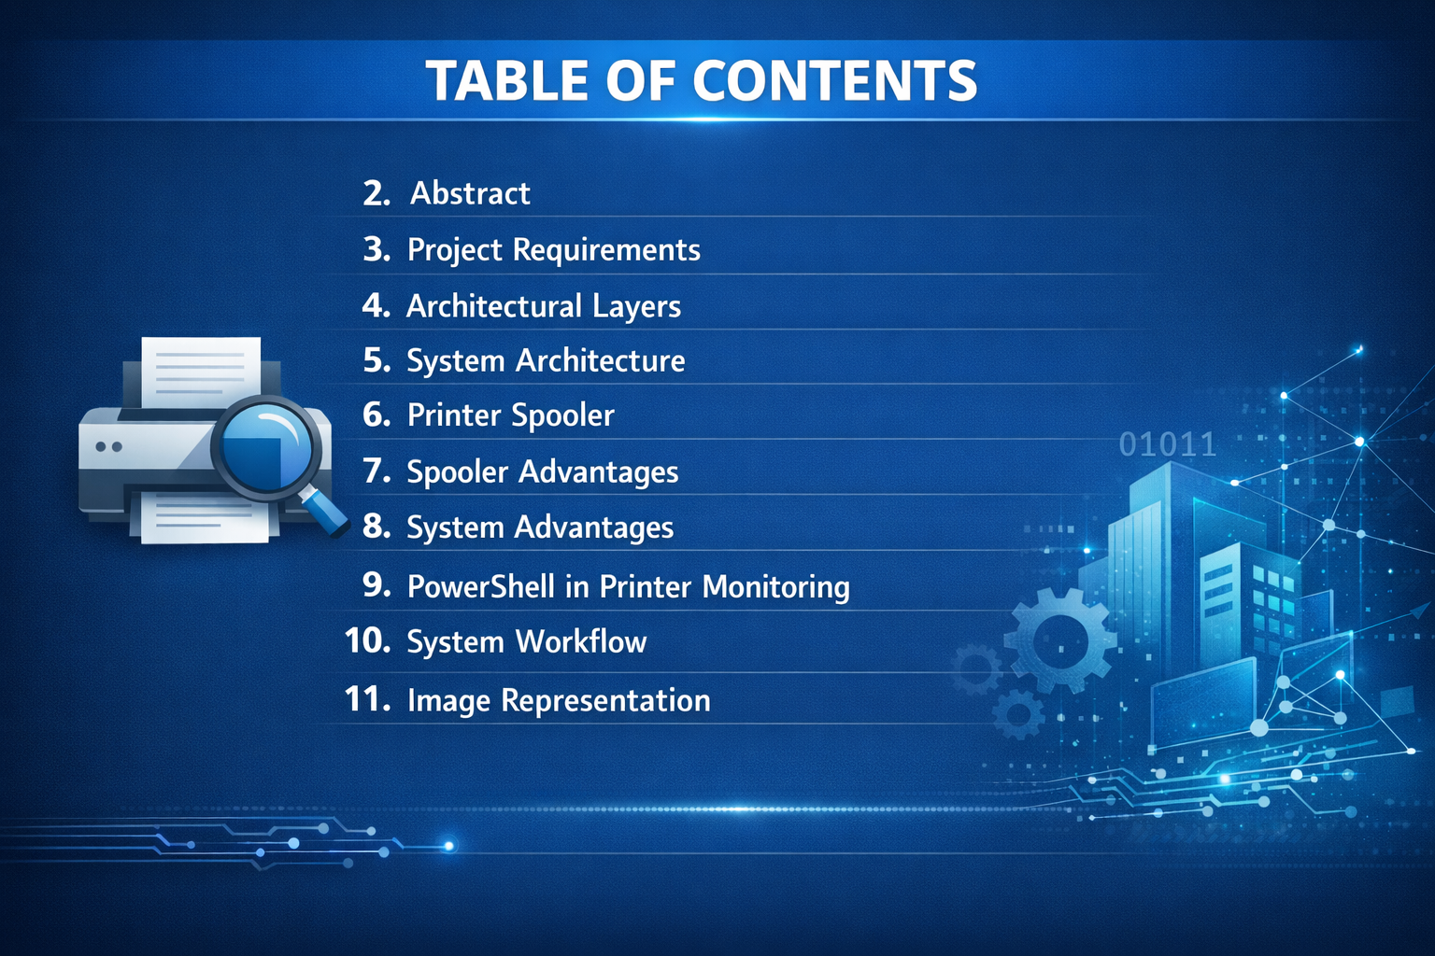
3

Slide 4
OVERVIEW
The Printer Monitoring Website is a web-based application developed to monitor and manage printer activities within an organization or institution. In many offices and computer laboratories, printers are shared among multiple users, which often leads to excessive paper usage, toner wastage, untracked print jobs, and difficulty in identifying printer errors. This project aims to provide a centralized system to track printer status, monitor print jobs, and generate usage reports in real time
4

Slide 5
PROJECT REQUIREMENTS
DEVELOPMENT TOOLS
PROGRAMMING STACK
  VISUAL STUDIO CODE (IDE)
  XAMPP (LOCAL SERVER)
  GOOGLE CHROME (WEB BROWSER)
  CLIENT-SIDE: HTML, CSS, JAVASCRIPT
  SERVER- SIDE: PHP, MYSQL,POWERSHELL
5

Slide 6
ARCHITECTURAL LAYERS AND EXPLANATION
CLIENT LAYER (PRESENTATION LAYER)
Components:
    Web Browser
    HTML, CSS, JavaScript
FunctiON:
    PROVIDES USER INTERFACE
    SHOWS PRINT REQUESTS
    DISPLAYS PRINTER STATUS
    SHOWS JOB LOGS AND REPORTS
USERS INTERACT WITH THE SYSTEM THROUGH A DASHBOARD.
6

Slide 7
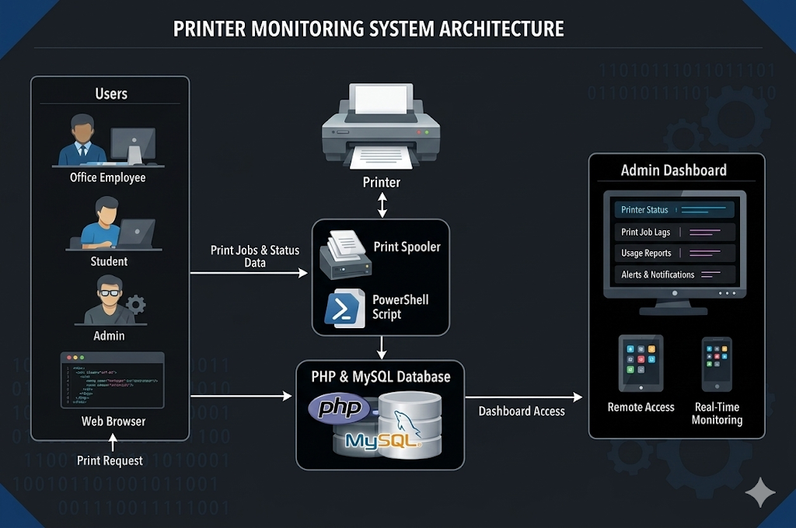
ARCHITECHTURE OF PRINTER MANAGEMENT
7

Slide 8
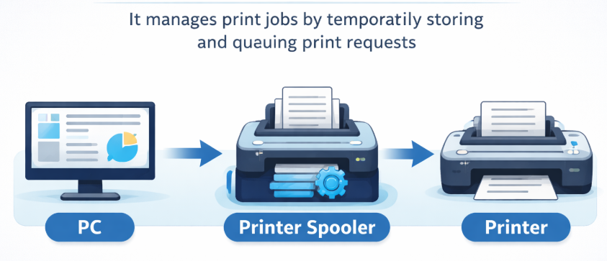
WHAT IS
PRINTER SPOOLER?
  A Print Spooler is a background service in an operating system that manages all print jobs sent to a printer.
  It temporarily stores print jobs in a queue and sends them to the printer one by one.
8

Slide 9
SPOOLER ADVANTAGES
  Queue Management: It orders and sequences multiple print jobs, allowing them to be processed in the correct order.
  Performance: It improves efficiency by freeing up applications while the printer processes, preventing the computer from waiting for the printer to finish.
  Job Control: It allows users to view, delete, or restart print jobs in the queue.
  Resource Handling: It loads necessary printer drivers and converts data types (e.g., EMF, RAW) to Aensure the printer understands the document.
  Spool Folder: Documents are held in a specific folder on the computer until the printer is ready.
9

Slide 10
ADVANTAGES
  CENTRALIZED CONTROL – MANAGE AND MONITOR ALL PRINTERS FROM ONE WEB
DASHBOARD.
  Real-Time Print COUNT TRACKING – AUTOMATICALLY UPDATES TOTAL PAGES
PRINTED AND USER-WISE USAGE.
  COST & RESOURCE CONTROL – HELPS REDUCE PAPER AND TONER WASTE THROUGH
USAGE MONITORING.
  USER ACCOUNTABILITY – LOGS EACH PRINT JOB WITH USERNAME AND TIME FOR
TRANSPARENCY.
  REMOTE ACCESS – ADMIN CAN MONITOR PRINTERS ANYTIME FROM ANY DEVICE
USING A BROWSER.
10

Slide 11
USING POWERSHELL IN PRINTER MONITORING
Printer monitoring using PowerShell is a method used to track and manage printer activities through command-line scripts in Windows systems. PowerShell interacts with the Print Spooler service, which handles all print jobs before they are sent to the printer. By using PowerShell commands, administrators can monitor printer status, view print queues, and manage print jobs efficiently.
11

Slide 12
SYSTEM WORKFLOW
User → Printer connected system
↓
Send Print Job
↓
Print Spooler
↓
PowerShell Monitoring Script
↓
PHP stores data in MySQL
↓
Admin Dashboard shows logs
12

Slide 13
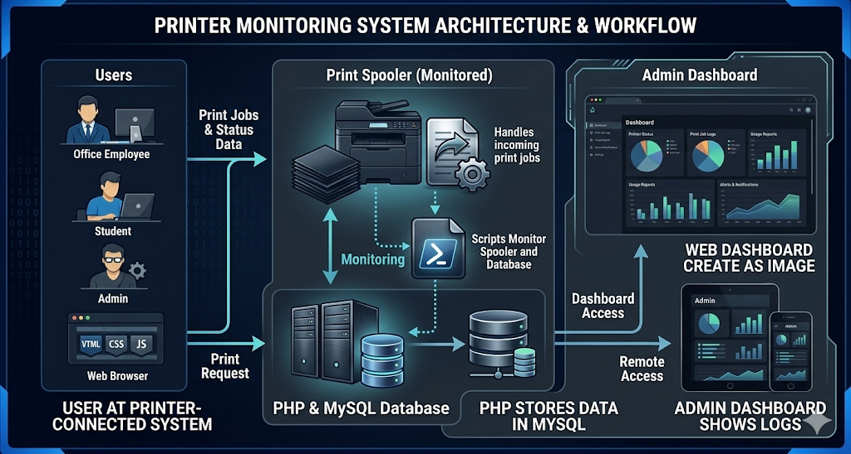
IMAGE REPRESENTATION
13

Slide 14
ANY QUESTIONS
14

Slide 15

15

